Slide 1
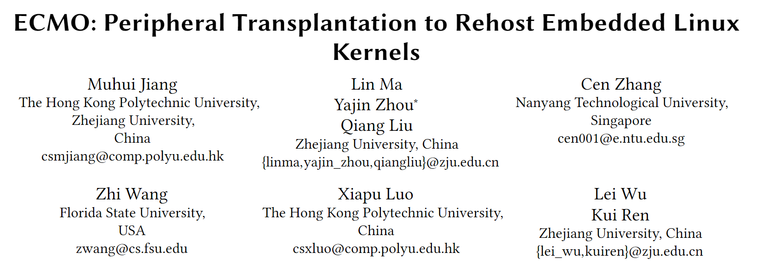
2021 ACM SIGSAC

Slide 2

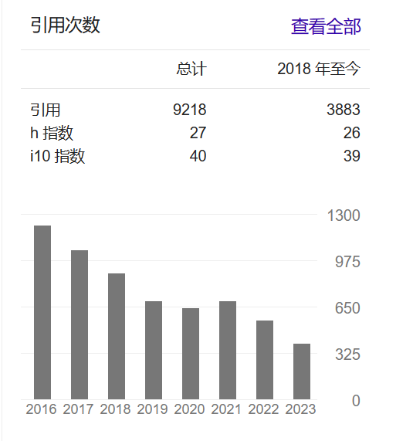
周亚金
浙江大学
Block chain security
System security
个人主页：Yajin Zhou@Zhejiang University

Slide 3
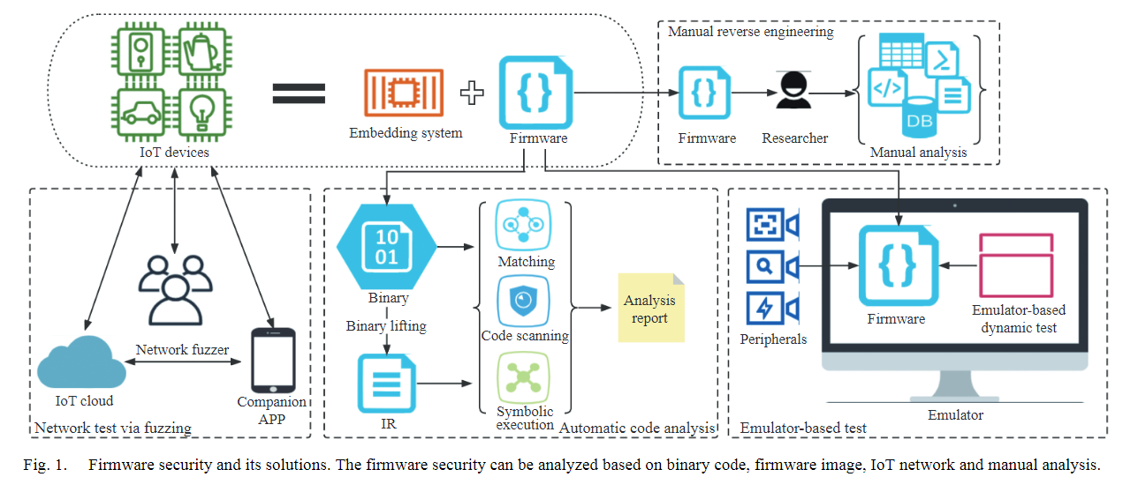
Background
IoT security testing
静态分析
动态分析

Slide 4
Prior work
FirmAE: Towards Large-Scale Emulation of IoT Firmware for Dynamic Analysis（ACSAC 20’）
Qemu full-system emulation, customzed kernel
Adapted from firmadyne(NDSS 16’)
{HALucinator}: Firmware Re-hosting Through Abstraction Layer Emulation(USENIX Security 20’)
Using High Abstract layer to emulate between firmware and hardware for bare metel systems
P2IM: Scalable and Hardware-independent Firmware Testing via Automatic Peripheral Interface Modeling (USENIX Security 20’)
Symbolic execution infering desired feedback from real devices

Slide 5








Observation-1
Firmware kernel rehosting is an open question
Interrupt controler
firmware
standard
Chip specific
timer
IoT devices
UART
peripherals
Kernel module

Slide 6
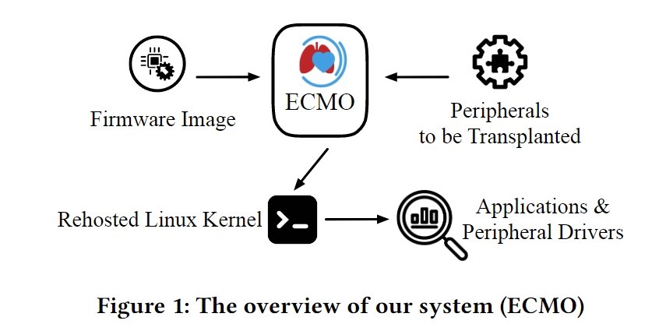
Observation-2
Customized kernel only have minor modifications
Focusing on early-boot peripherals helps rehosting
i.e., interrupt controller, timer, and UART
Users can install drivers by themselves
Replacing them with supported peripherals!

Slide 7
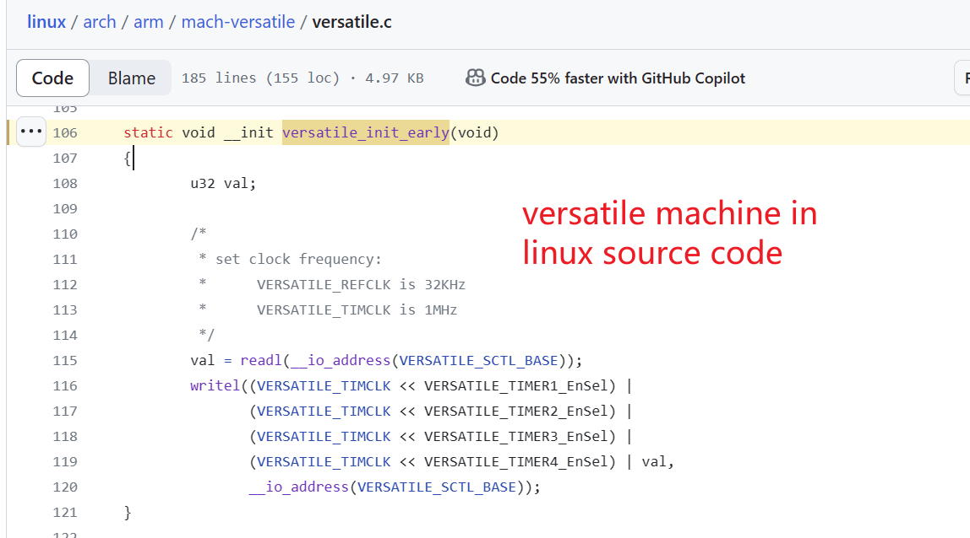
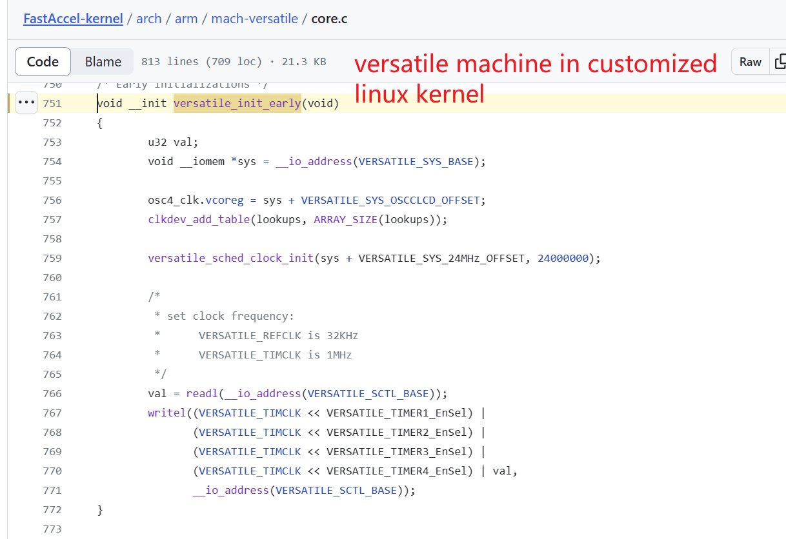
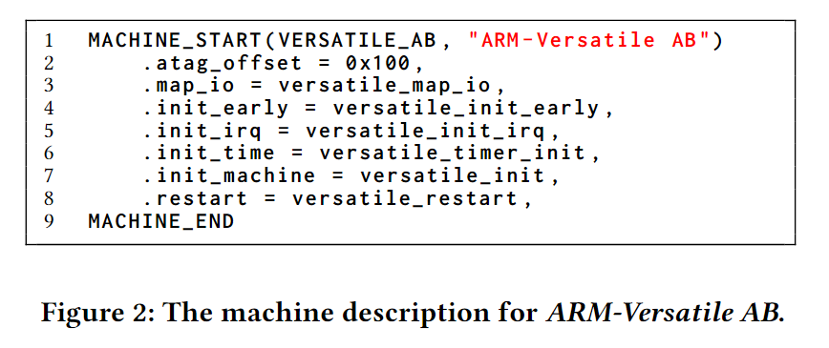
Example
Arm MACHINE
Specific peripheral in SOC
lies in linux kernel
Qemu may not support
Needs driver code
Custom LG G Watch kernel

Slide 8
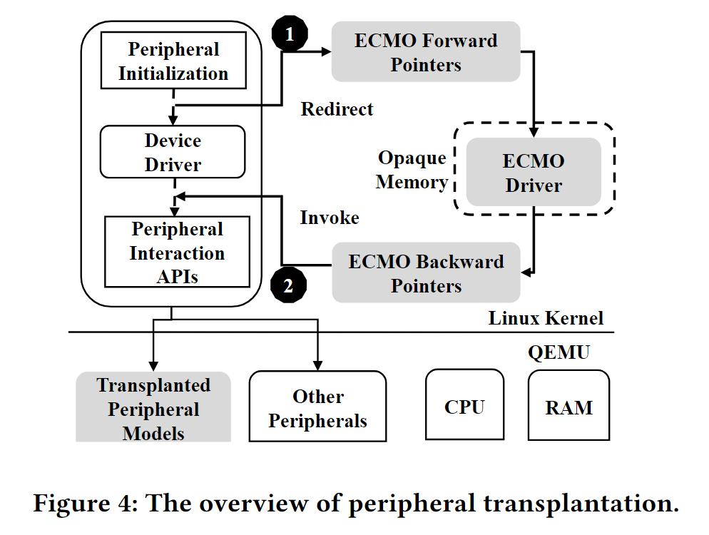
solution
Peripheral transplantation

Slide 9
Contributions
Novel technique
peripheral transplantation can rehost Linux kernels of embedded devices without the availability of the source code
New system
Integreted into qemu and become Ecmo
Comprehensive evaluation
710/815 (87.1%) kernels can launch shells

Slide 10
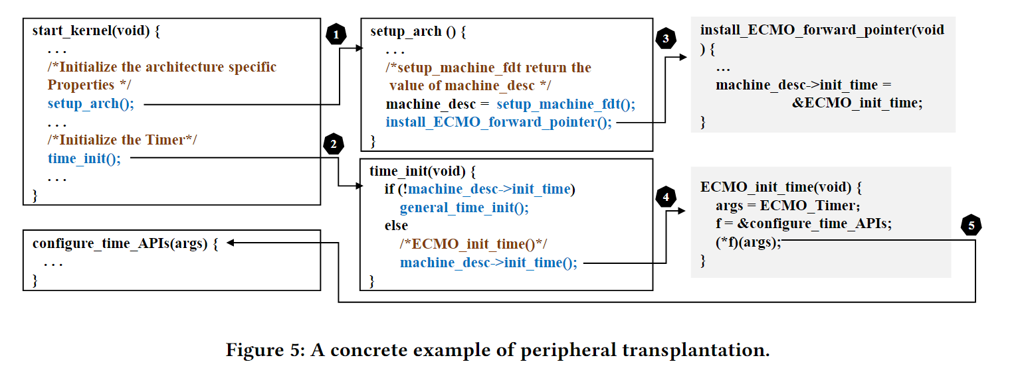
Idea Example

Slide 11
Methodology
1. Decompress Linux Kernel
Precise identify kernel start address in firmware.bin
2. Identity ECMO Pointers
Replacing them with Qemu-supported one later
Forward(for boot) and backward(for use)
3. Generate ECMO Drivers
Manually writes supported kernel drivers

Slide 12
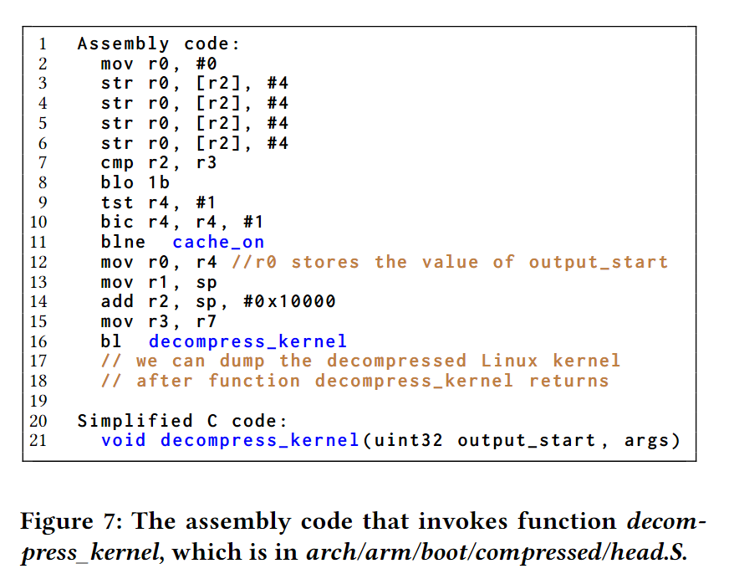
Decompress Linux Kernel
Decompressing kernel’s assembly code
Hook or find in Qemu
bl decompressed_kernel
Get kernel start address

Slide 13
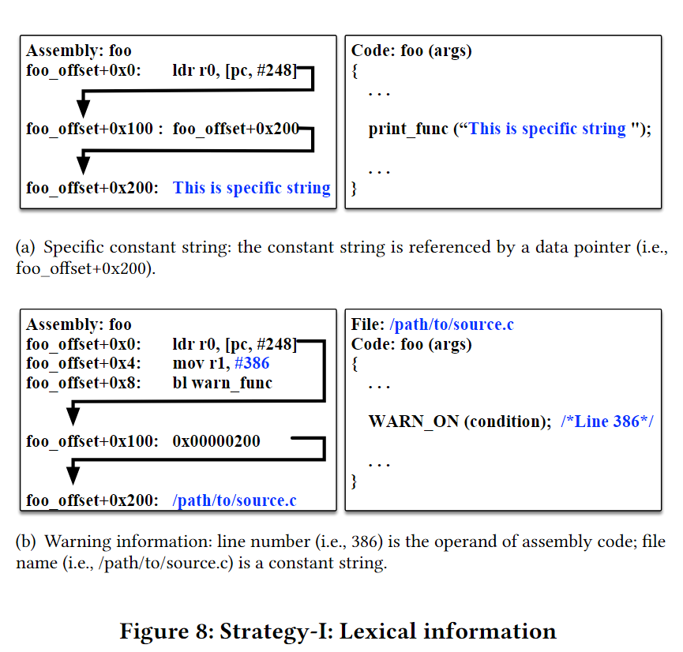
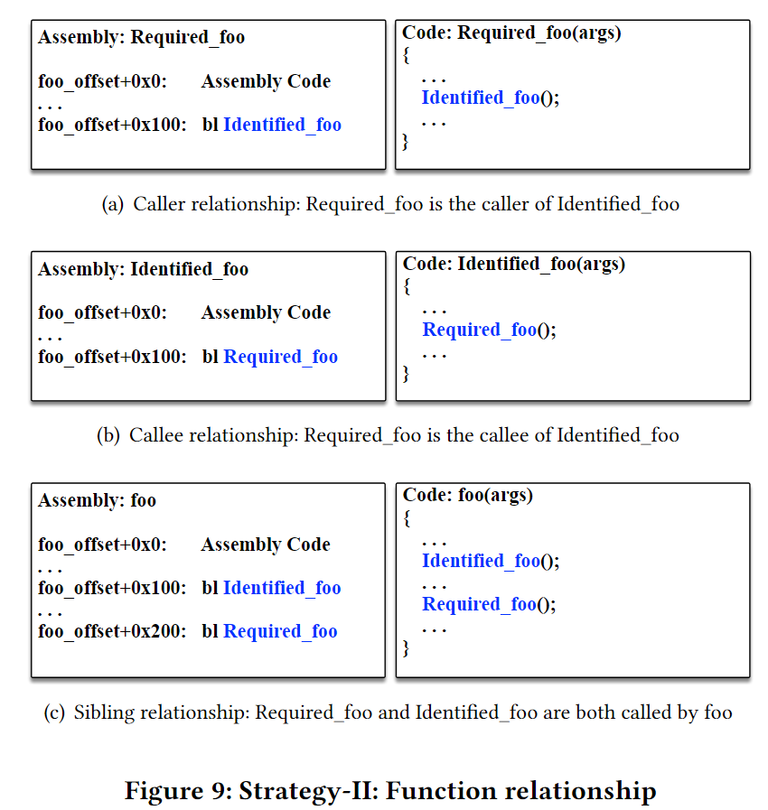
Identity ECMO Pointers(1)
Strategy-I: lexical information
Strategy-II: Function relationship

Slide 14
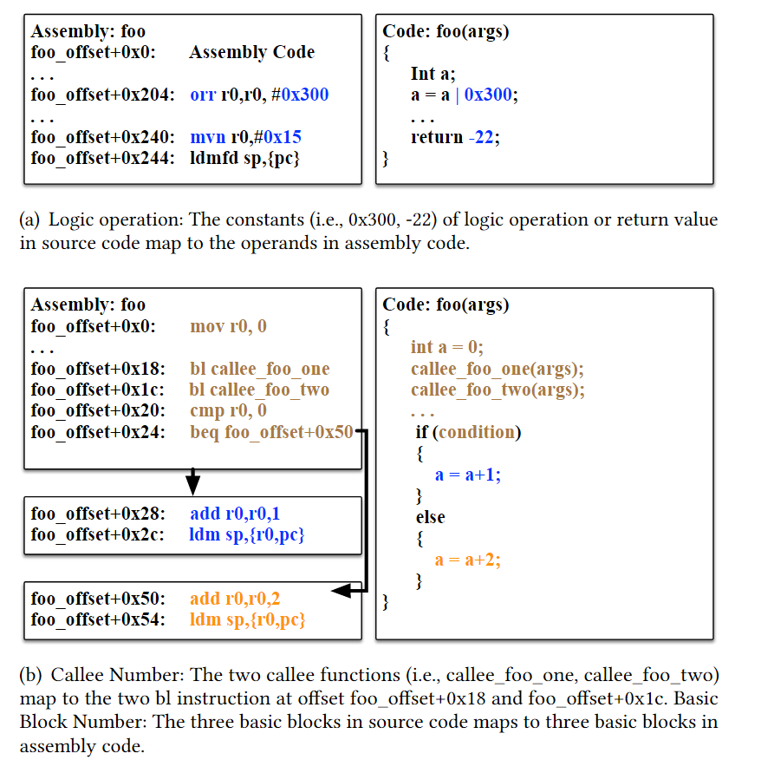
Identity ECMO Pointers(2)
Strategy-III : Function structure
Count of basic blocks
Arithmetic operations
Return value
Count of callee functions
Function structure

Slide 15
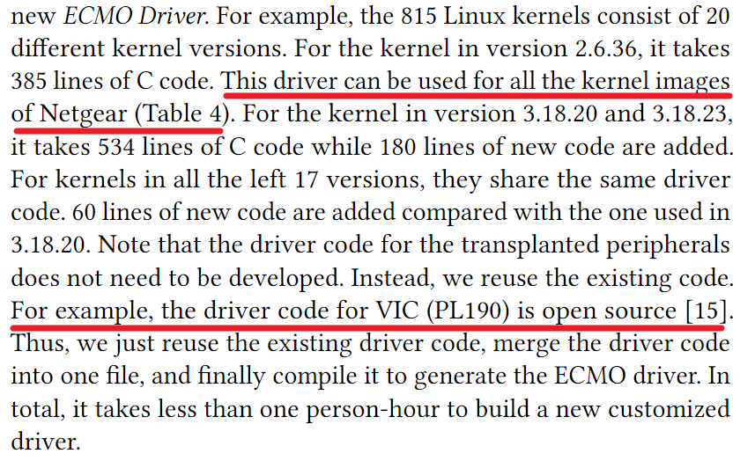
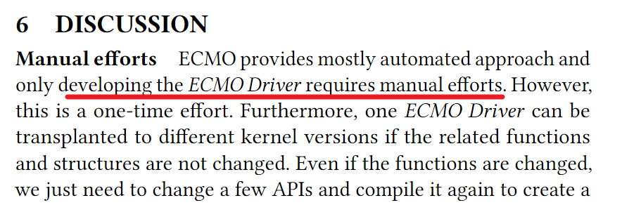
Generate ECMO Drivers
Manually written to mimic original driver code and functions
Scalable for many devices, one-time effort

Slide 16
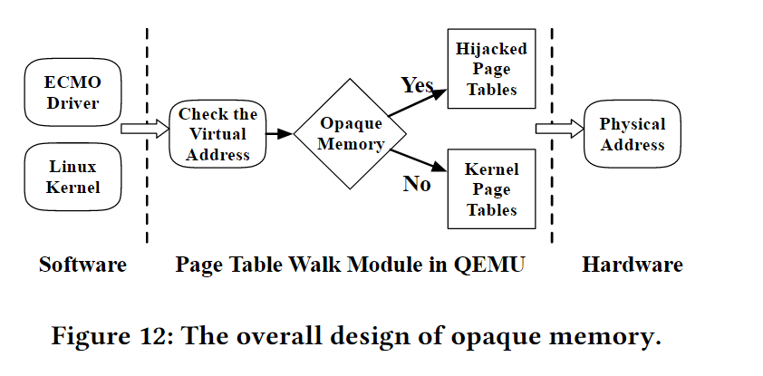
Integrate into kernel
Opaque memory
Directly load into kernel memory will be rewritten by kernel

Slide 17
Evalutaion
RQ1: Auucracy of Identifing ECMO Pointers
RQ2: success rate of Rehosting Linux Kernels
RQ3: Reliability and Stability
RQ4:security Applications and Other Peripherals

Slide 18
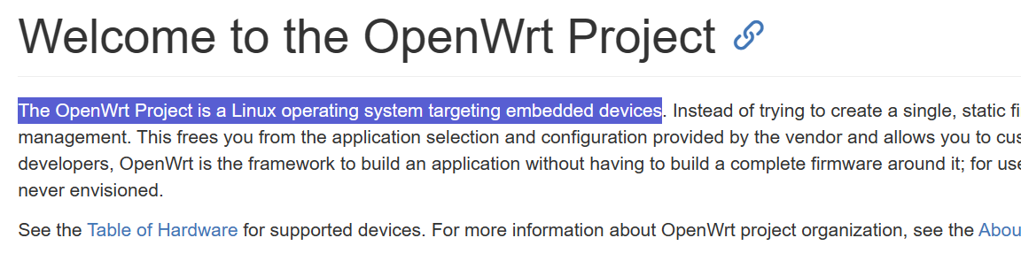
Dataset
Arm devices
720 in OpenWRT and 95 in Netgear, 815 altogether，contains linux kernels

Slide 19
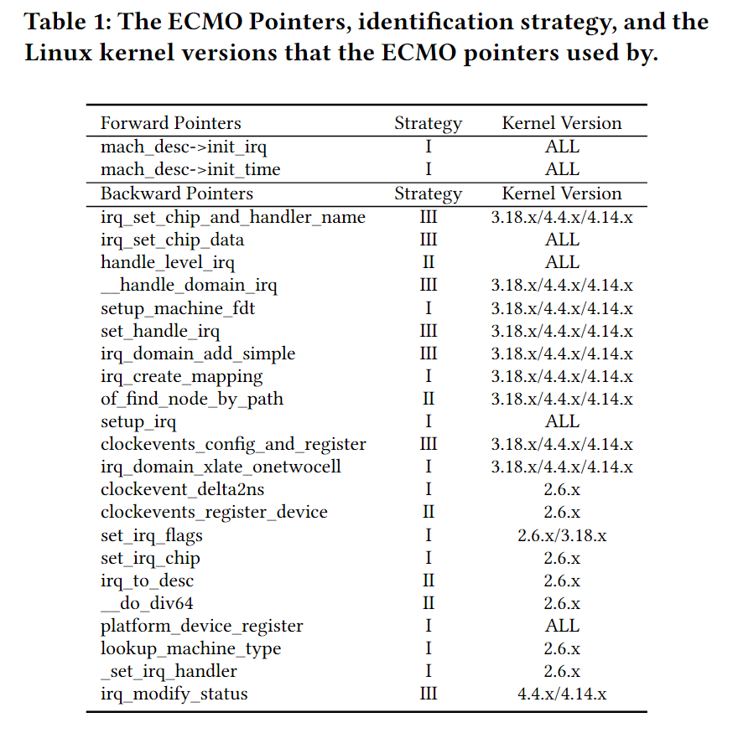
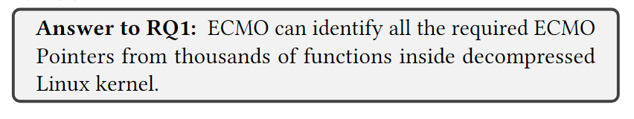
Identify ECMO Pointers (RQ1)
Success rate: 100%

Slide 20
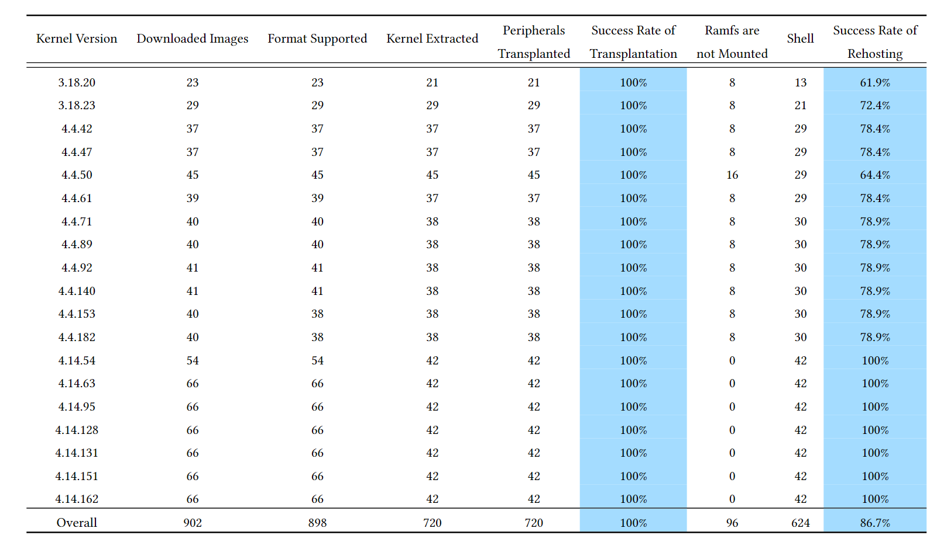
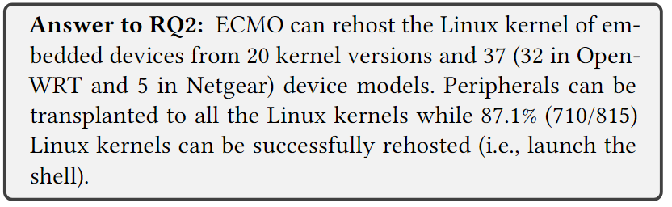
Rehost Linux Kernels (RQ2)
Success of transplantation:
handler function can handle corresponding queries
Soccess of rehosting:
can spawn a shell

Slide 21
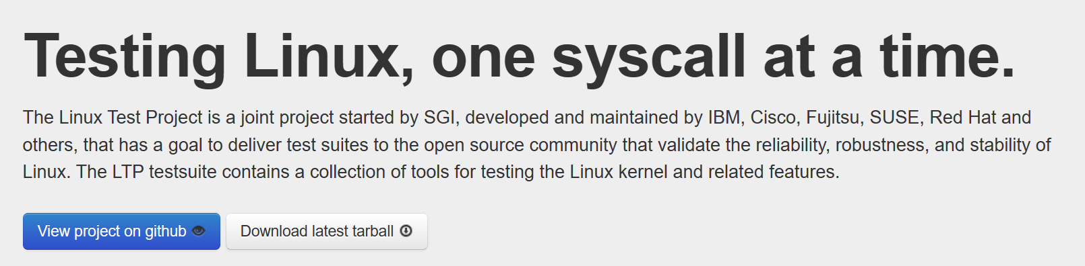
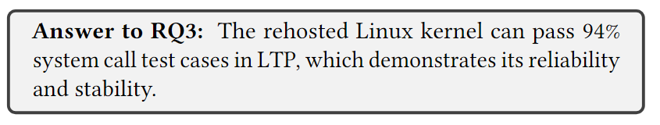
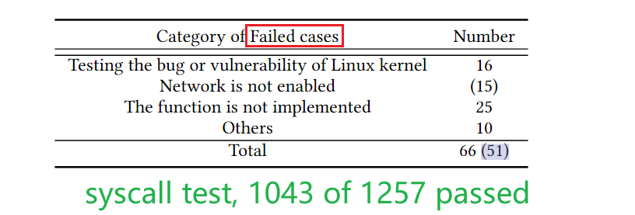
Reliability and Stability (RQ3)
Use LTP (Linux Test Project) to test kernel

Slide 22
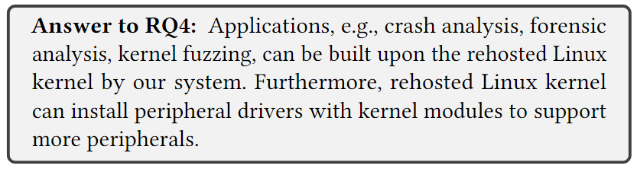
Applications and Other Peripherals (RQ4)
Peripherals
Author developed a kernel module and successfully installed it into all 720 successfully rehosted kernels
Rootkit Forensic Analysis.
Identify several rootkit using security tools
Fuzzing supported
Unicorn fuzz reaches high speed

Slide 23
Drawbacks and disscussion
Developing Peripherals requires manual effort
Only early-boot Peripherals (UART,timer,IC)
Only arm machines

